Slide 1
F10W AD WINs
Himavad

Slide 2
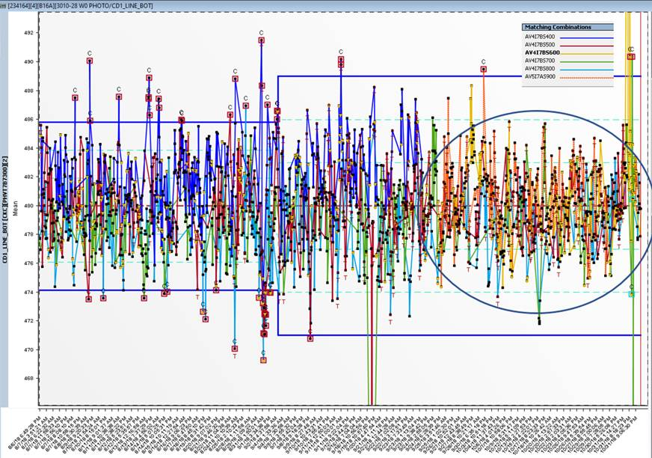
Chronic OOC AD - Win
S400 metro tool toggle discovered using AD result. Verified it was true & got metro team to LPRO & investigate on affected tool. Overall CD performance improves after problem tool is stopped

Slide 3
F10N AD WINs
shaunteohw

Slide 4
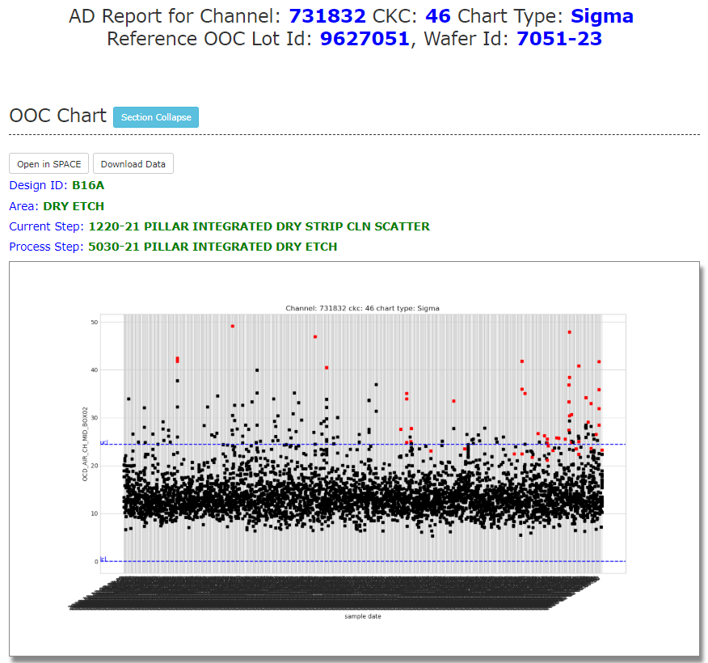
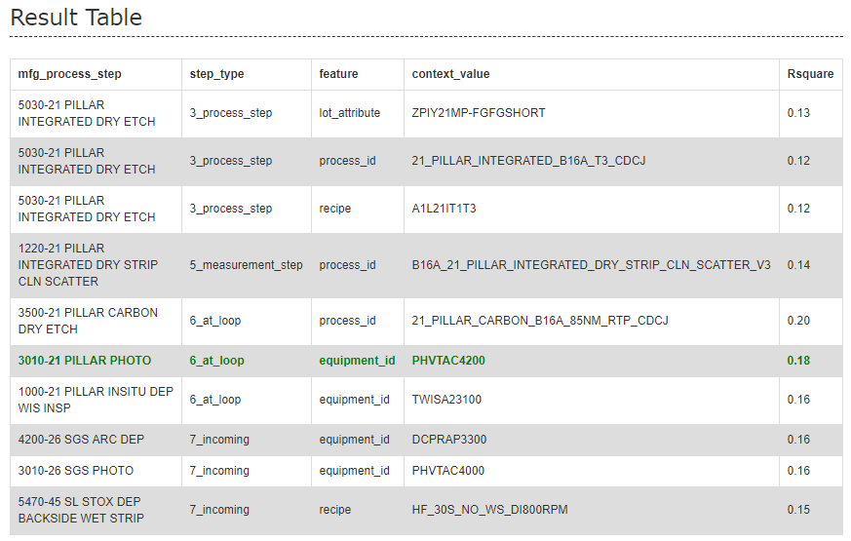
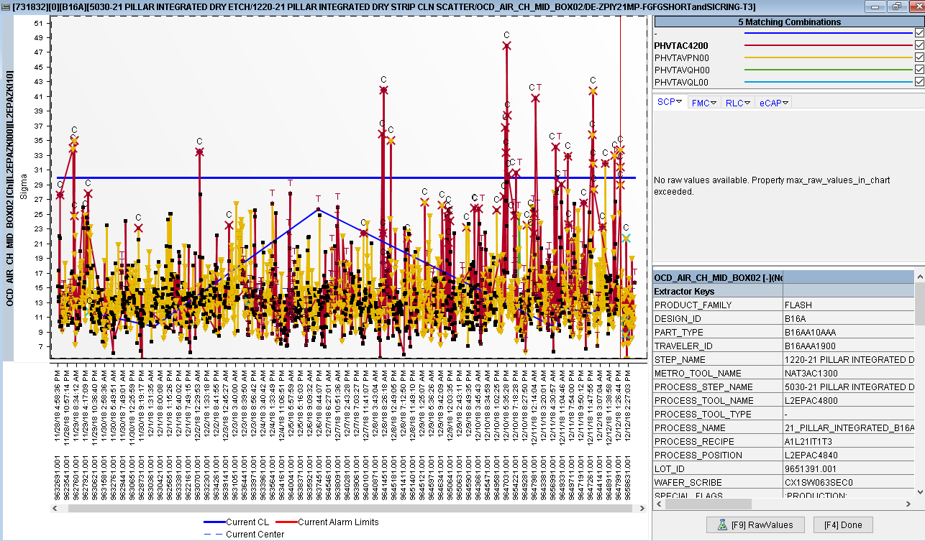
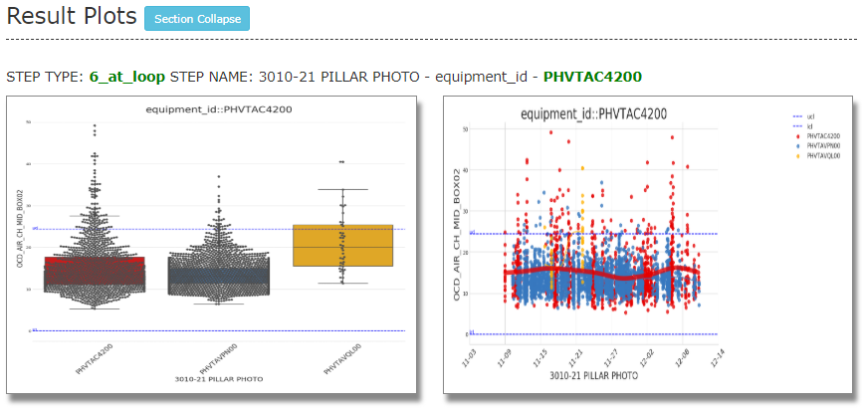
(WINs) B16A 21INT OCD Sigma OOC Issue
AD Report/Highlight
AD Analysis
Manual Verification (longer trend)
Root cause found i.e. incoming 21Photo scanner C42 toggling worse off 21INT OCD sigma
AD able to identify incoming toggle through channel level analysis
Manual verification done via SPACE chart to confirm root cause

Slide 5
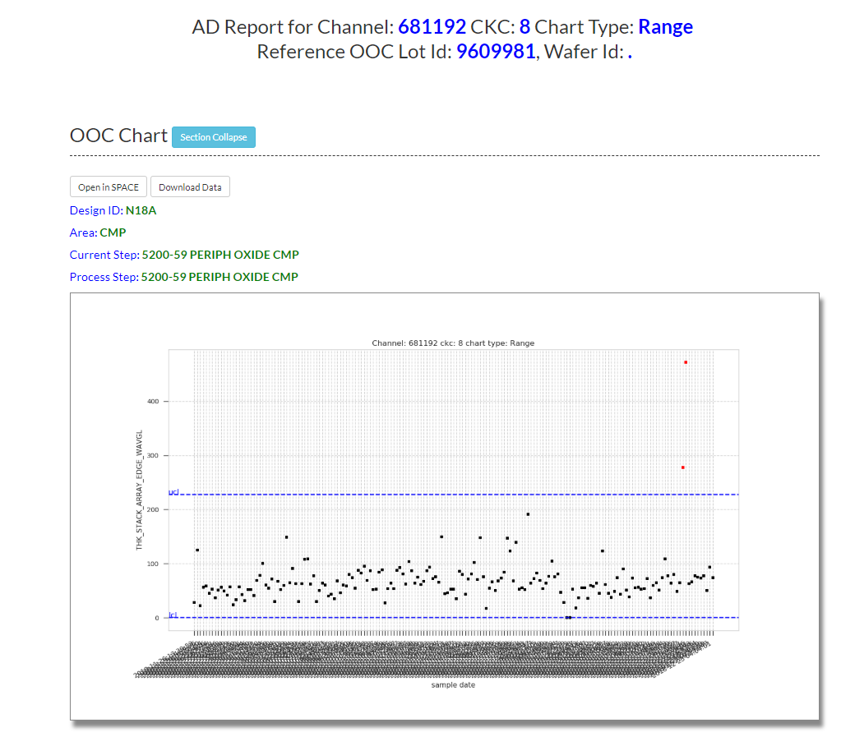
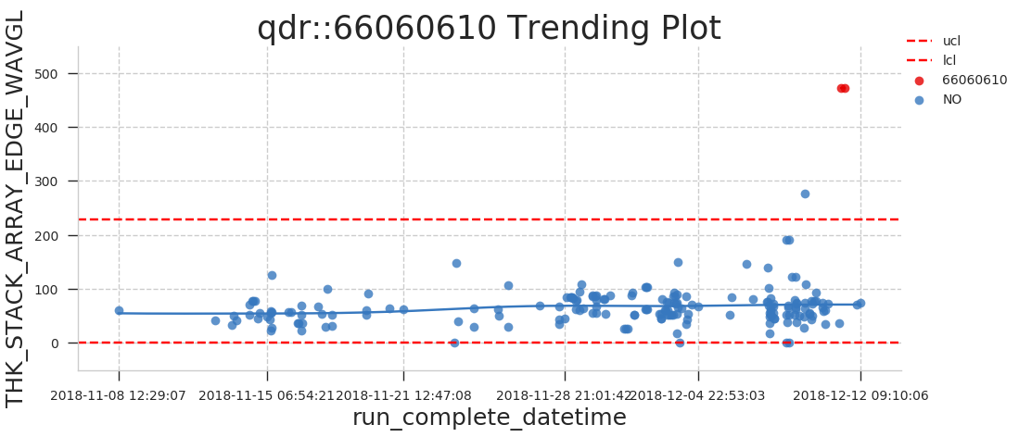
(WINs) N18A 59 CMP QDR Issue
Wins:
Able to diagnostic the incoming QDR related toggle.
QDR number available for further troubleshooting and investigation.

Slide 6
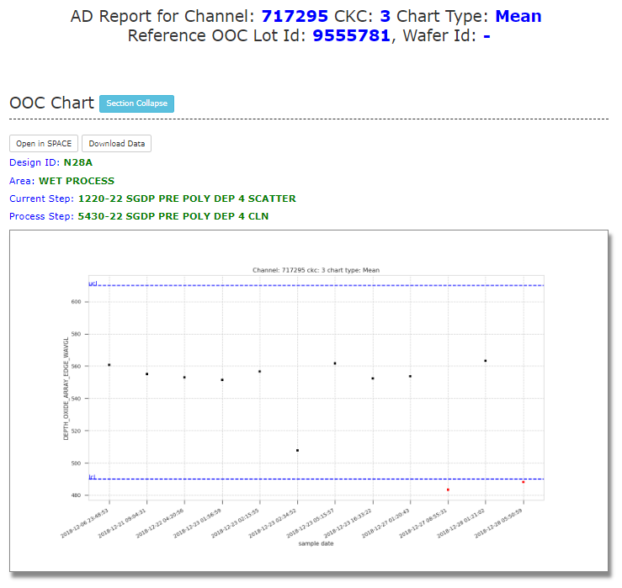
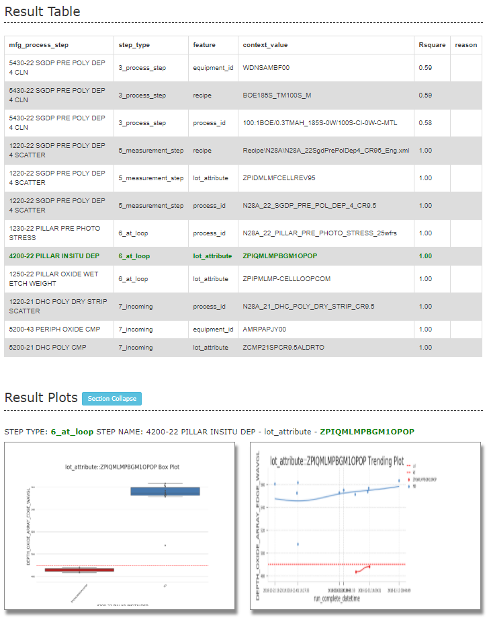
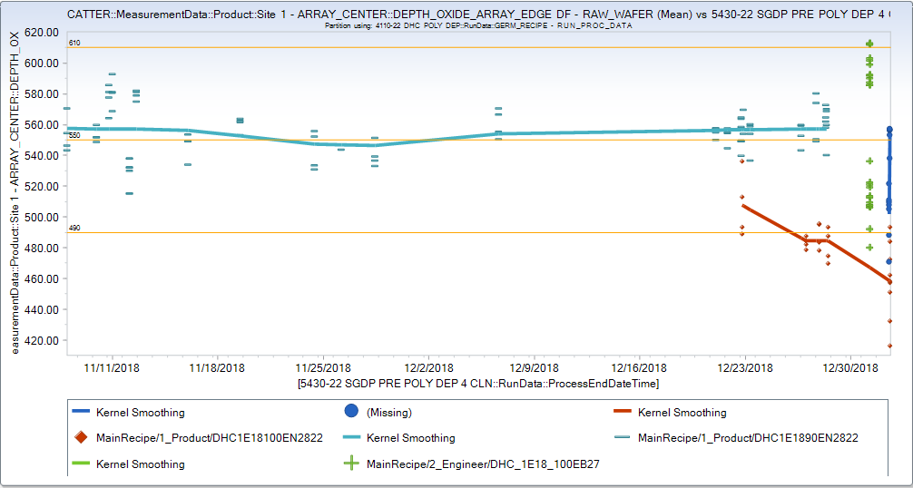
(WINs) N28A 22 SGDP PRE POLY DEP CLN - Mean OOC
AD Report/Highlight
AD Analysis
PO Investigation
Report strongly suggests incoming lot attribute as root cause of OOC
Helped PO to rule out possibility of process step drift. Further check via Yield3 shows OOC low lots have same attribute from incoming step
Actual root cause identified as new conversion recipe/attribute from incoming 4110-22 DHC POLY DEP.

Slide 7
Positive Experience
AD report is able generate/load very quickly
Good first pass check on potential incoming step(within loop)/current step toggles which translates to shorter troubleshooting time
Data available 24/7 for PEE to check any incoming toggle.
Convenient AD report link in the chronic OOC dashboard.
Improved the work efficiency, save productivity time.

